Slide 1
EMPLOYEE MANAGEMENT SYSTEM
Streamline HR Management Tool​
TEAM
Prioty Hossain ID:242-35-276
Jannatul Fardous ID:242-35-156
Rusafi Bin Rowshan ID:242-35-520

Slide 2
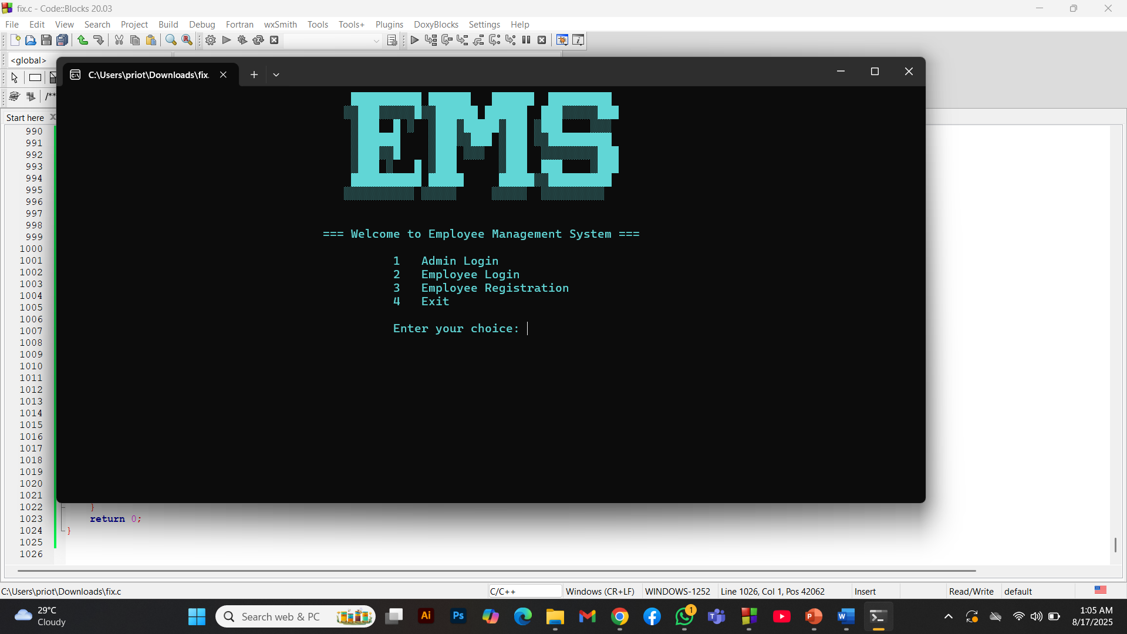
INTRODUCTION
The Employee Management System is a console-based HR solution developed in C.It provides both admin and employee interfaces for managing personnel records, applications, and notices.

Slide 3
Key Features:
Employee registration & profile management
Leave and general application system
Admin approval workflows
Notice board functionality

Slide 4
FUNCTIONALITIES
User (Employee) Features:
Profile Viewing: Access personal and educational details
Application System: Submit leave/general applications
Status Tracking: View approval status
Notice Board: View company announcements

Slide 5
FUNCTIONALITIES
Admin Features:
Employee Management: Add / View / Search / Delete records
Application Processing: Approve / Deny leave requests
Notice Publishing: Broadcast announcements
Comprehensive Reporting: View all employee data

Slide 6
USER MANUAL
Start
Run compiled C program (EMS.c)
System shows logo and main menu
2. Login
Admin → Password: admin1234
Employee → Valid Employee ID

Slide 7
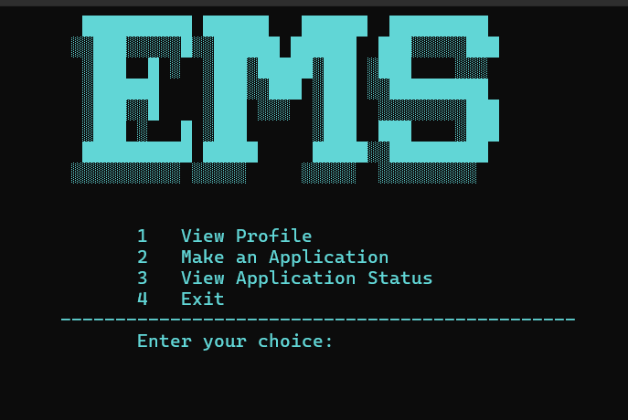
USER MANUAL
Employee Dashboard
View Profile
Make Applications (leave/general)
View Status
View Notices

Slide 8
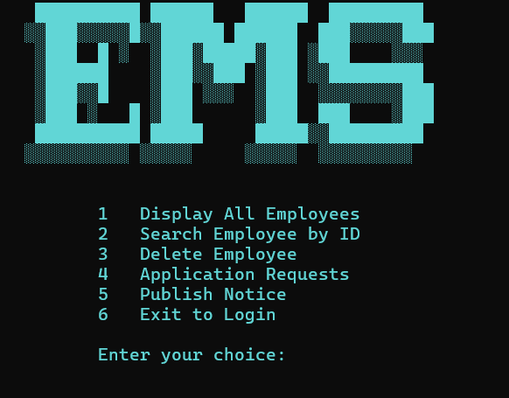
USER MANUAL
Admin Dashboard
Employee Management: Register, View, Search, Delete
Application System: Process pending requests, Approval history
Notice Board: Publish company-wide notices Reporting: Generate lists, View login logs

Slide 9
File Storage:
ems.txt → Employee records
applications.txt → Applications
login log.txt → Login history
Notices stored in memory (runtime)

Slide 10
REAL-LIFE IMPACT
Modernized HR Processes:
Replaces paper-based records
Removes manual tracking
Centralized information
Operational Efficiency:
Reduces workload
Instant data access
Faster leave approval
Accessibility:
Runs on Windows with C compiler
No database required
Simple text-file storage

Slide 11
CONCLUSION
The Employee Management System shows:
Comprehensive HR management in C
Strong file handling capabilities
Secure authentication system
Practical business application

